Slide 1


Data Processing/Analysis/Science with R
Al.I. Cuza University of Iași
Faculty of Economics and Business Administration
Department of Accounting, Information Systems and Statistics
Basic Options for Data Input and Output
(Import and Export)
By Marin Fotache

Slide 2
Web sites with R tutorials for data input/output
R Data Import/Export
http://cran.r-project.org/doc/manuals/r-release/R-data.html
Beginner's guide to R: Get your data into R
http://www.computerworld.com/article/2497164/business-intelligence/beginner-s-guide-to-r-get-your-data-into-r.html
Reading/Writing Data: Part 1
https://www.youtube.com/watch?v=aBzAels6jPk&index=9&list=PLjTlxb-wKvXNSDfcKPFH2gzHGyjpeCZmJ
Reading/Writing Data: Part 2
https://www.youtube.com/watch?v=aBzAels6jPk&index=9&list=PLjTlxb-wKvXNSDfcKPFH2gzHGyjpeCZmJ
Importing Data Into R from Different Sources
http://www.r-bloggers.com/importing-data-into-r-from-different-sources/
Data Import & Export in R
http://science.nature.nps.gov/im/datamgmt/statistics/r/fundamentals/index.cfm

Slide 3
Web sites with R tutorials for data input/output (cont.)
Reading data from the new version of Google Spreadsheets
http://blog.revolutionanalytics.com/2014/06/reading-data-from-the-new-version-of-google-spreadsheets.html
This R Data Import Tutorial Is Everything You Need
https://www.datacamp.com/community/tutorials/r-data-import-tutorial#gs.wWkdN3Y
Importing Data Into R - Part Two - Read more at: https://www.datacamp.com/community/tutorials/importing-data-r-part-two#gs.odSNCOo
http://www.r-bloggers.com/r-tutorial-on-reading-and-importing-excel-files-into-r/
https://vimeo.com/130548869
http://www.r-bloggers.com/importing-data-into-r-part-two/

Slide 4
Script associated with this presentation
https://github.com/marinfotache/Data-Processing-Analysis-Science-with-R/blob/master/02%20Basic%20Data%20Import%20and%20Export/02a_basic_data_input_output.R

Slide 5
Loading data into statistical packages
Traditional solutions:
Direct import from external data files (Excel, CSV, text files etc.) using their menus
Save intermediate results from the data sources into common format files (XML, CSV, JSON ) and then import these intermediate files into R;
Create data sources using ODBC or JDBC and import the data into R
Some more recent options:
Customized ETL procedures
Connecting to special APIs or web/data services which provide data sets in formats easy to import (e.g. Google Analytics)
Import data from web servers log into NoSQL data stores
Performing database query in a database server directly from the statistical package.

Slide 6
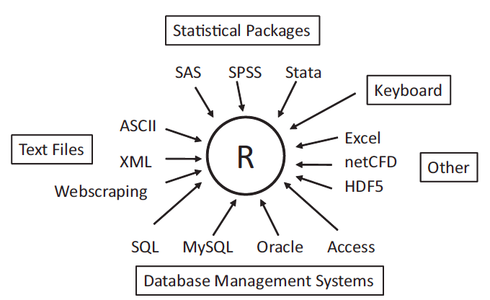
Sources of Data in R (adapted from [Kabacoff, 2011])
APIs
NoSQL Data Stores
Hadoop

Slide 7
Loading data into an R session
Source (File) Type | Base R functions | Recommended packages | Other packages
.RData file | load()
Clipboard | read.table
Delimited text file (.txt) | read.table | readr read_tsv read_delim
Comma separated files (.csv) | read.table | readr read_csv read_delim
Excel files (.xlsx/.xls) |  | readxl read_excel excel_sheets | openxlsx xlsReadWrite XLConnect xlsx
PostgreSQL dabase tables/views |  | RPostgreSQL | DBI

Slide 8
Loading data into an R session (cont.)
Source (File) Type | Base R functions | Recommended packages | Other packages
SPSS data file |  | rio import | foreign read.spss haven read_spss
STATA data file |  | rio import | foreign read.dta haven read_dta read_stata
SAS data file |  | rio import | foreign read.ssd haven read_sas

Slide 9
Access Oracle databases through JDBC
Package ROracle was intended to provide access to Oracle databases
Unfortunately, now package ROracle is not available
Next example was inspired by http://www.r-bloggers.com/connecting-r-to-an-oracle-database-with-rjdbc/
As the name suggests, the solution needs dealing with some Java "things"
Requirements: JDK/JRE previously installed
Download ojdbc jar from www.oracle.com (in my case, ojdbc6.jar)
Set JAVA_HOME, set max. memory, and load rJava library
Sys.setenv(JAVA_HOME='/path/to/java_home')
on my Mac OS:
> Sys.setenv(JAVA_HOME='/Library/Java/JavaVirtualMachines/jdk1.7.0_45.jdk/Contents/Home')
> options(java.parameters="-Xmx2g")
> install.packages("rJava")
> library(rJava)

Slide 10
Access Oracle databases through JDBC (cont.)
Getting some information
Java version
> .jinit()
> print(.jcall("java/lang/System", "S", "getProperty", "java.version"))
classPath (just for the record)
> .jclassPath()
Load RJDBC package
> Install.packages(RJDBC)
> library(RJDBC)
Create connection driver and open connection
> jdbcDriver <- JDBC(driverClass="oracle.jdbc.OracleDriver",
classPath="/Users/admin/Downloads/ojdbc6.jar")

Slide 11
Access Oracle databases through JDBC (cont.)
Open connection
> jdbcConnection <- dbConnect(jdbcDriver,
+ "jdbc:oracle:thin:@//10.10.0.7:1521/orcl",
+ "bd2",
+ "bd2")
Launch the Oracle query and store the result into the data frame st
> st <- dbGetQuery(jdbcConnection,
+ "SELECT * FROM studenti")
Close connection
> dbDisconnect(jdbcConnection)

Slide 12
Saving/Exporting R data
Destination (File) Type | Base R functions | Recommended packages | Other packages
.RData file | save.image save
Delimited text file (.txt) | write.table | readr write_tsv write_delim | rio - export
Comma separated files (.csv) | read.table | readr write_csv write_delim | rio - export
Excel files (.xlsx/.xls) |  | writexl write_xlsx | openxlsx xlsReadWrite XLConnect xlsx rio
PostgreSQL dabase tables/views |  | RPostgreSQL | DBI

Slide 13
Saving/Exporting R data (cont.)
Source (File) Type | Base R functions | Recommended packages | Other packages
SPSS data file |  | rio export | foreign write.foreign haven write_sav
STATA data file |  | rio export | foreign write.foreign haven write_dta write_stata
SAS data file |  | rio export | foreign write.foreign haven write_sas

